Slide 1
Rapid Transit Network and Innovation
Taqhi Mohammed and Ryan Ruehle
Pace Suburban Bus
Arlington Heights, IL
www.pacebus.com

Slide 2
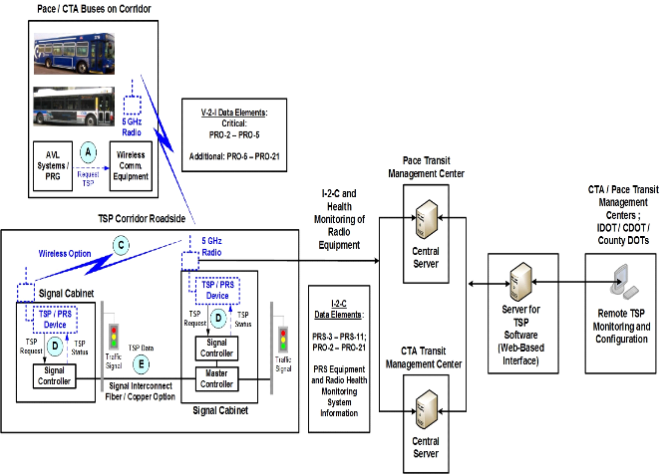
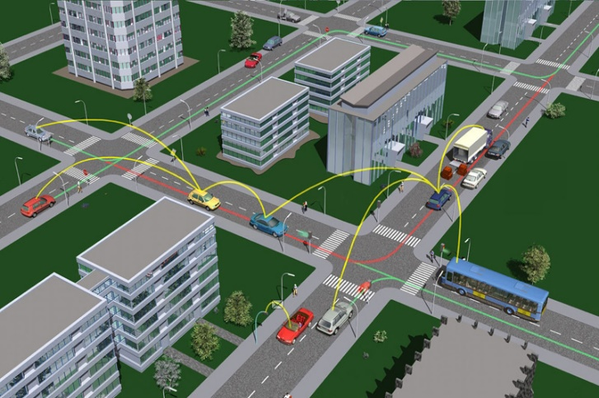
Smart Transit Initiatives
ITS Product, Firmware and Software Development
Traffic Signal Timing Optimization
Transit Signal Priority (TSP) Systems Integration and Deployment
Connected Vehicles Applications
Integrated Dynamic Transit Ops (IDTO)
Autonomous Vehicles (AV) Feasibility
Transportation as a Service (TaaS)
Mobility on Demand (MoD)

Slide 3
Pace
Bus Delay Study

Slide 4
Pace’s Innovative Signal Timing Optimization
Increased Corridor SPEED:
Pace Connected Signal Interconnects for continuous Green
Optimized Signal Timing along 10 Transit Corridors and Approximately 400 Intersections
:
Revised the current approach and introduced Green Band Progression for entire Corridor

Slide 5
Pace’s Transit Signal Priority (TSP) Program
TSP facilitates the movement of transit vehicles through traffic signal controlled intersections by extending the green phase, shortening the red phase/early green.
TSP Solution Salient Features: IoT Design Approach
NTCIP 1211 SCP/Open Standards and Non Proprietary
Software Solution : No additional TSP Equipment on Bus and at ATC Signal Controllers
Use of existing Pace bus 5GHZ Radio and GPS
Centralized Monitoring and Data Analytics
Regionally Interoperable between CTA, Pace, IDOT & CDOT

Slide 6
TSP-Systems Architecture

Slide 7
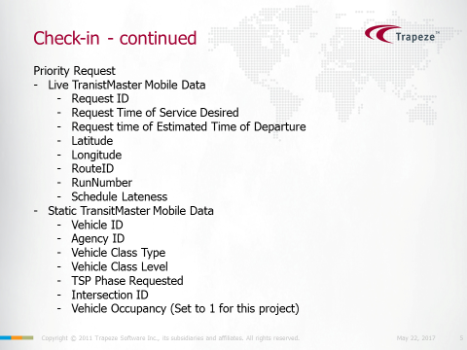
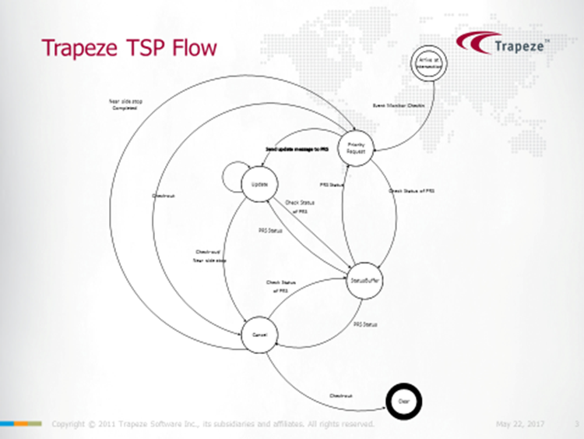
Priority Request Generator (PRG) Software
Trapeze Bus Software Modification
Use Existing 5GHZ Radio
No TSP equipment on Bus
Message Set Flow Diagram
Software Deployed -Testing
Vehicle to Intersection (V2I)
SNMP V1 Communication
Two Way Communication
First 802.11 n Application
Live Transit Master Data

Slide 8
Priority Request Server (PRS) Software
Chicago Specific PRS Software Developed by AEGIS ITS
Econolite Cobalt ATC Controller- EOS Platform under testing
No Equipment in the Signal Controller
Vehicle to Intersection (V2I) using 5GHz Radio.
IP Scheme and AES 256 Data Encryption

Slide 9
Priority Request Server (PRS) Product and Central Software Development
Chicago Specific PRS Firmware and Hardware under development by Novax Industries.
Central TSP Monitoring Software by Novax and Parsons
Can Work with Legacy Controllers
Includes Regional TSP Message Set
Remotely configurable software system
Linux OS for reliable system operation.
Input and Output options to support Serial, Ethernet and other signals

Slide 10
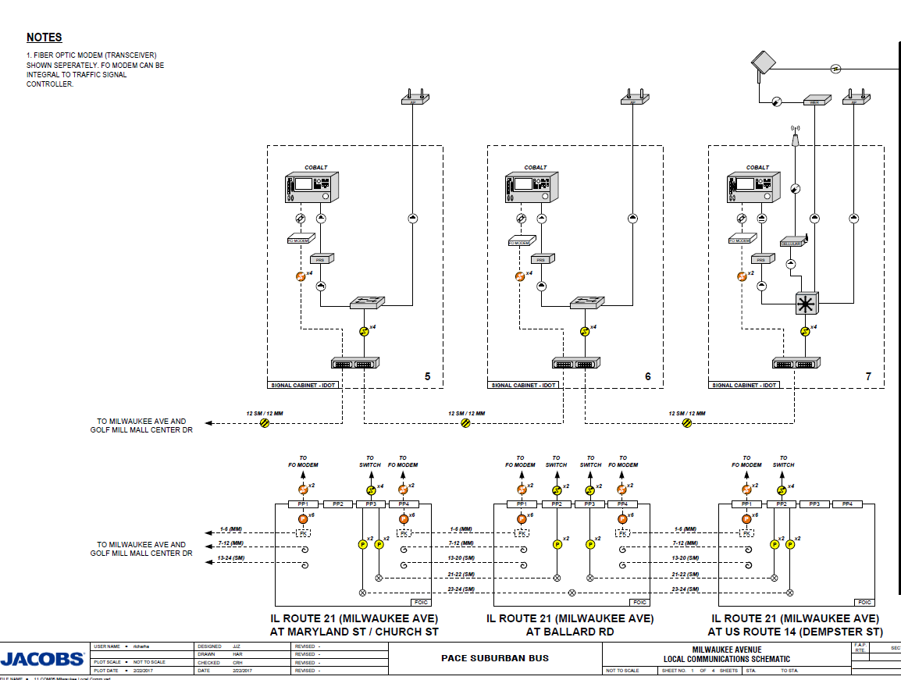
Milwaukee Ave – IDOT Signals

Slide 11
Transit Signal Priority Program Task Flow Chart
Regional TSP Requirements
and Interoperable
Standards Development
Technology: Wi-Fi (802.11n) & 5.0 GHz
Features: Interoperable, NTCIP 1211 message
set, open standards, non-proprietary
Status: Completed
Deployment :2018-19
Cermak Rd
Cicero Ave
Sibley/147th
Roosevelt Rd
159th St
95th St
Grand Ave (Lake )
Rand Rd (Partial)
Dempster St (ART)
Halsted St
I-90 Access
Trapeze AVL Software
Development (Completed)
Milwaukee Ave TSP
(Proof of Concept) 2017-18
PRS Software ATC Signal
Controllers (Completed)
Regional Signal Timing Optimization
Implementation and TSP Strategies
Scope: Approx. 400 Signals – Milwaukee Ave
Cicero Ave, Sibley/147th, Roosevelt Rd, 95th St,
Dempster St, Cermak Rd, 159thSt
Grand Ave and Rand Road
Status : Completed April 2017
PRS Product & Central Software
Development (On-Going)
Design, PS&E, Permits, Systems
Integration for 10 Corridors (On Going)

Slide 12
TSP Next Steps
ATC-EOS Deployment along Roosevelt Road
Centralized Transit Signal Priority (TSP)
County DOT TMC and Pace Center to Center (C2C) communication.
Lake and DuPage County TMC for C2C
City of Chicago (OEMC) and Pace Transit Center TSP – Data Sharing

Slide 13

Transit and Smart Urban Infrastructure
Support Smart infrastructure development for Connected Autonomous Vehicle Environment for I2I, V2I, I2C, V2I2C and TMC.
Connected Vehicle Technology
Autonomous Transit Vehicles
Intermodal Connectivity
Dynamic Modal Shift
Integrated Dynamic Transit Ops
Platoon Progression
Centralized Signal Control
- Transit Safety Applications

Slide 14
Connected Vehicles : Integrated Dynamic Transit Operations (IDTO)
T-DISP (Dynamic Transit Operations)
For the traveler, T-DISP provides an ability to access real-time information about available travel options in order to best manage their commute.
For an agency, T-DISP extends demand / response services to support dynamic routing and scheduling
T-CONNECT (Connection Protection) increases the likelihood of making successful transfers.
Dynamic Ride Sharing (D-RIDE) takes the concept of traditional pre-planned ridesharing (i.e Carpool and Vanpool) and brings it into the 21st century enabling drivers and travelers, in near real-time, to exchange information about needs.

Slide 15
CAV for First and Last Mile
Connected and Autonomous Vehicles (CAV) for first and last mile.
CAV testing and IDTO platform development using Machine Learning methods.
Collaboration with Regional Stakeholders (IDOT,IL Tollway, Argonne) and Tech Industry
IL AV Committee Support

Slide 16
Smart Transit Goals
Making bus transit network in tune with changing preferences of Public.
Use of Technology to increase system efficiency and speed.
Use dynamic data to augment integrated dynamic transit operations.
Accommodate Individual Choices and Preferences - Mobility on Demand
Work towards Transportation as a Service.

Slide 17
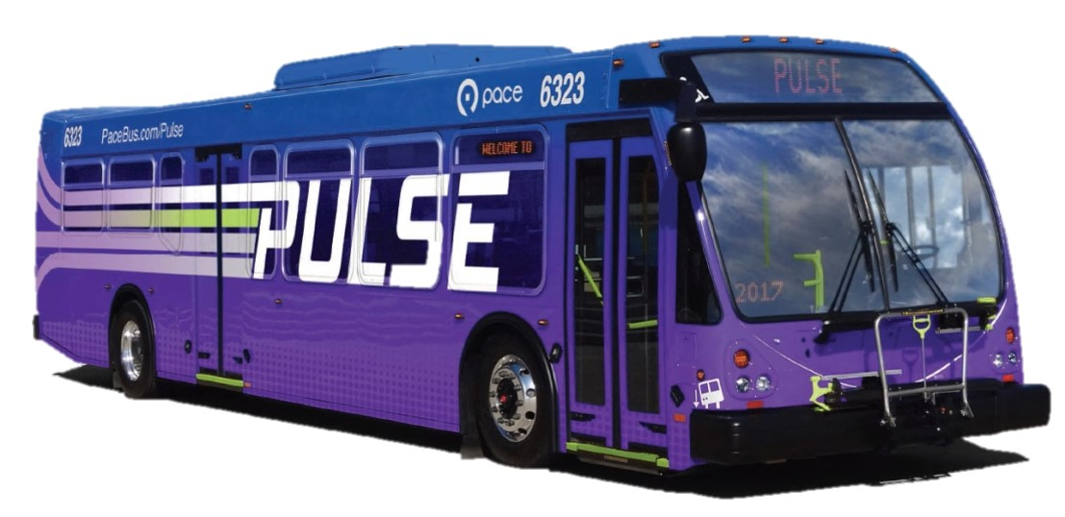
Integration with Pulse Program

Slide 18
Pace Rapid Transit Program
Umbrella term for premium transit options Pace is developing.
Involves infrastructure / capital, service and technology improvements.
Two main service types:
  Expressway-based service – Typically using bus-on-should (BOS)
  Pulse (sometimes referred to as ART)

Slide 19
What is Pulse?
1st Stage Bus Rapid Transit (BRT)
Features:
  Limited stop/station placement
  Faster, more frequent service
  Vehicle amenities
  Station amenities
  ITS integration

Slide 20
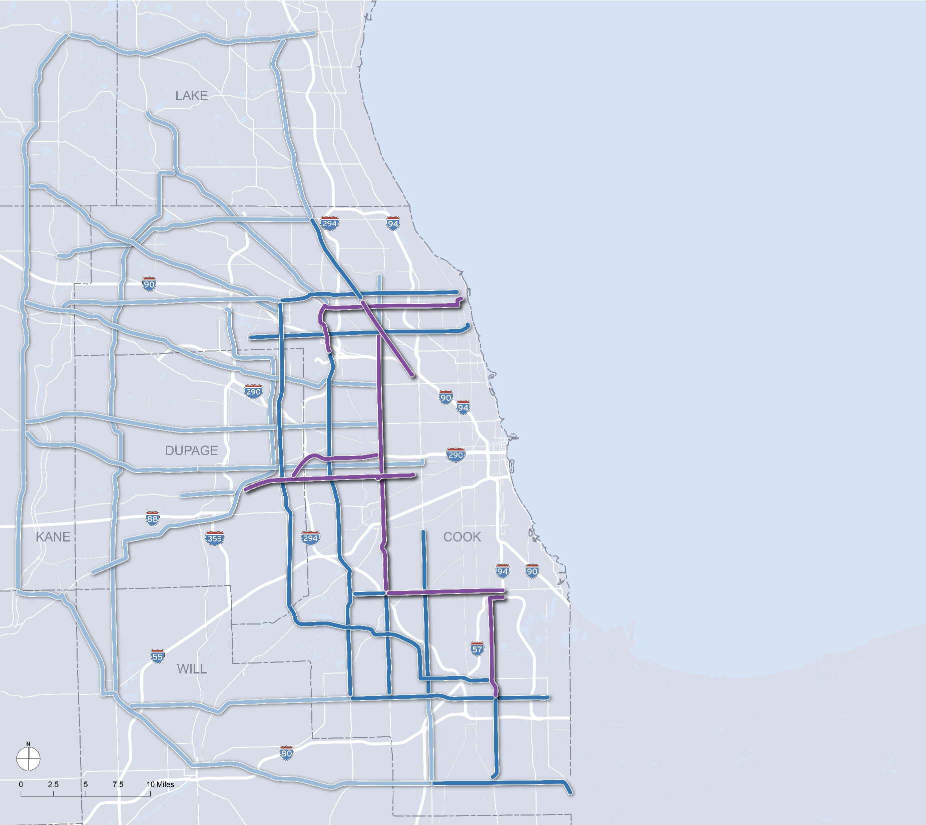

  Priority Routes
  Milwaukee Avenue
  2. Dempster Street
  3. Halsted Street
  4. 95th Street
  5. Cermak Road

Slide 21
Upcoming Pulse Lines
Pulse Milwaukee
  Construction to commence pending permits
  Expected completion and implementation in mid-2018
Pulse Dempster
  In Planning stages
  Currently conducting environmental review
  Expected implementation in 2020

Slide 22
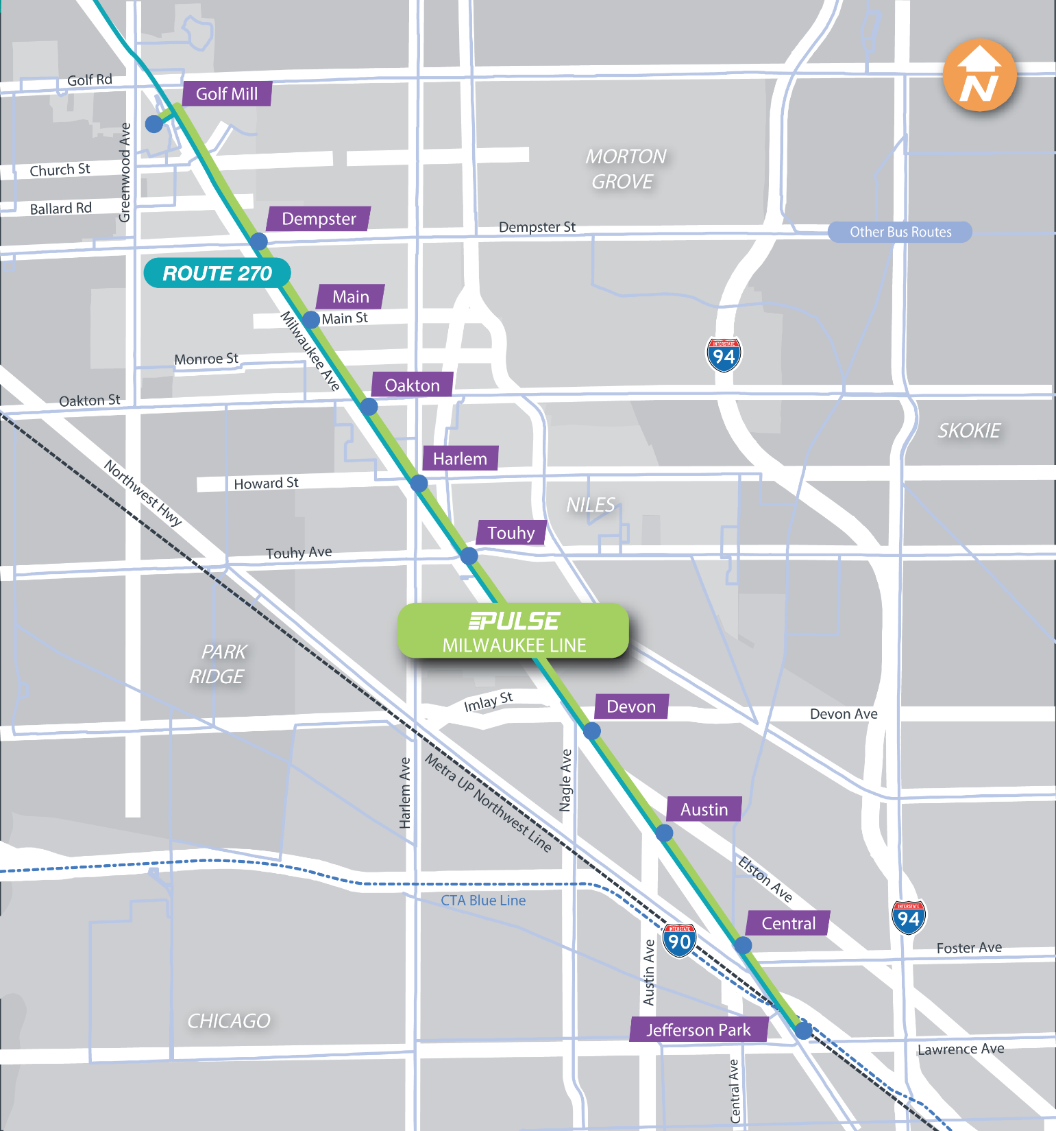
Pulse
Milwaukee
Map
Notes:
Limited Stop Spacing

Slide 23
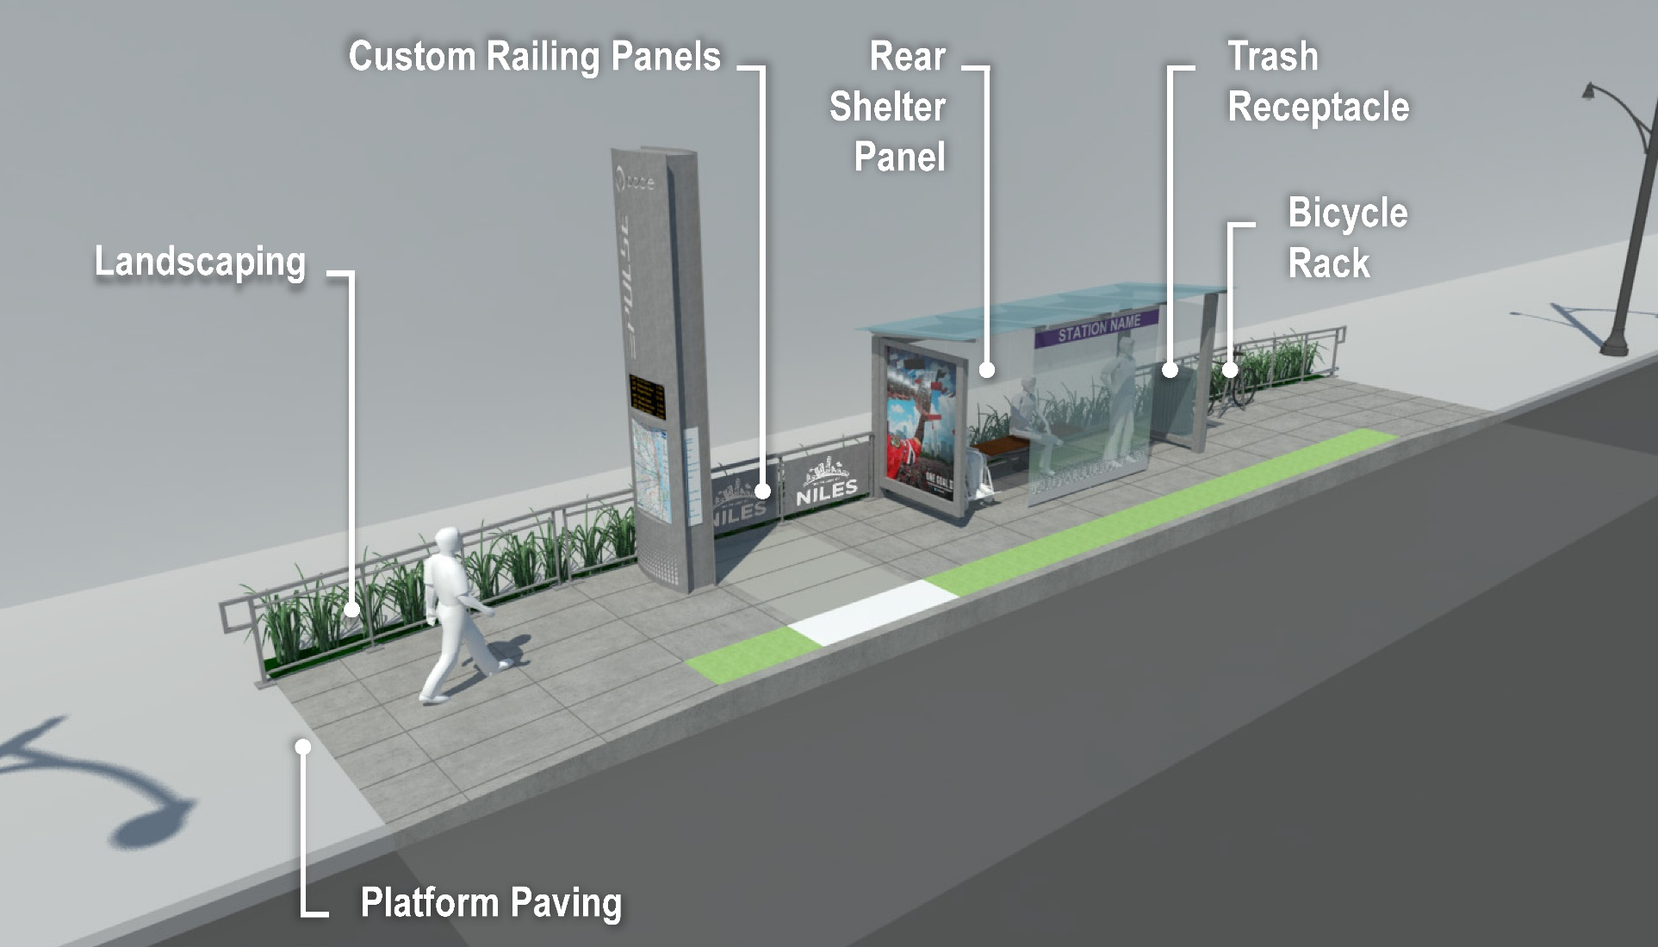
Station Features

Slide 24
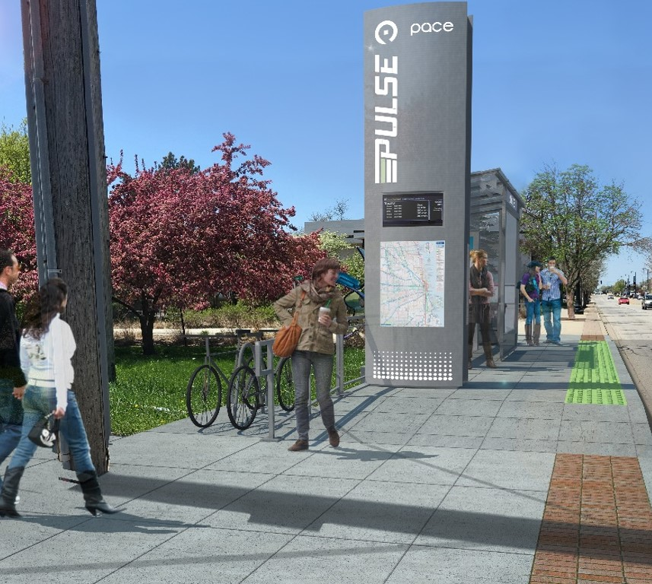
Station Examples
Notes:
Dempster EB (looking west)

Slide 25
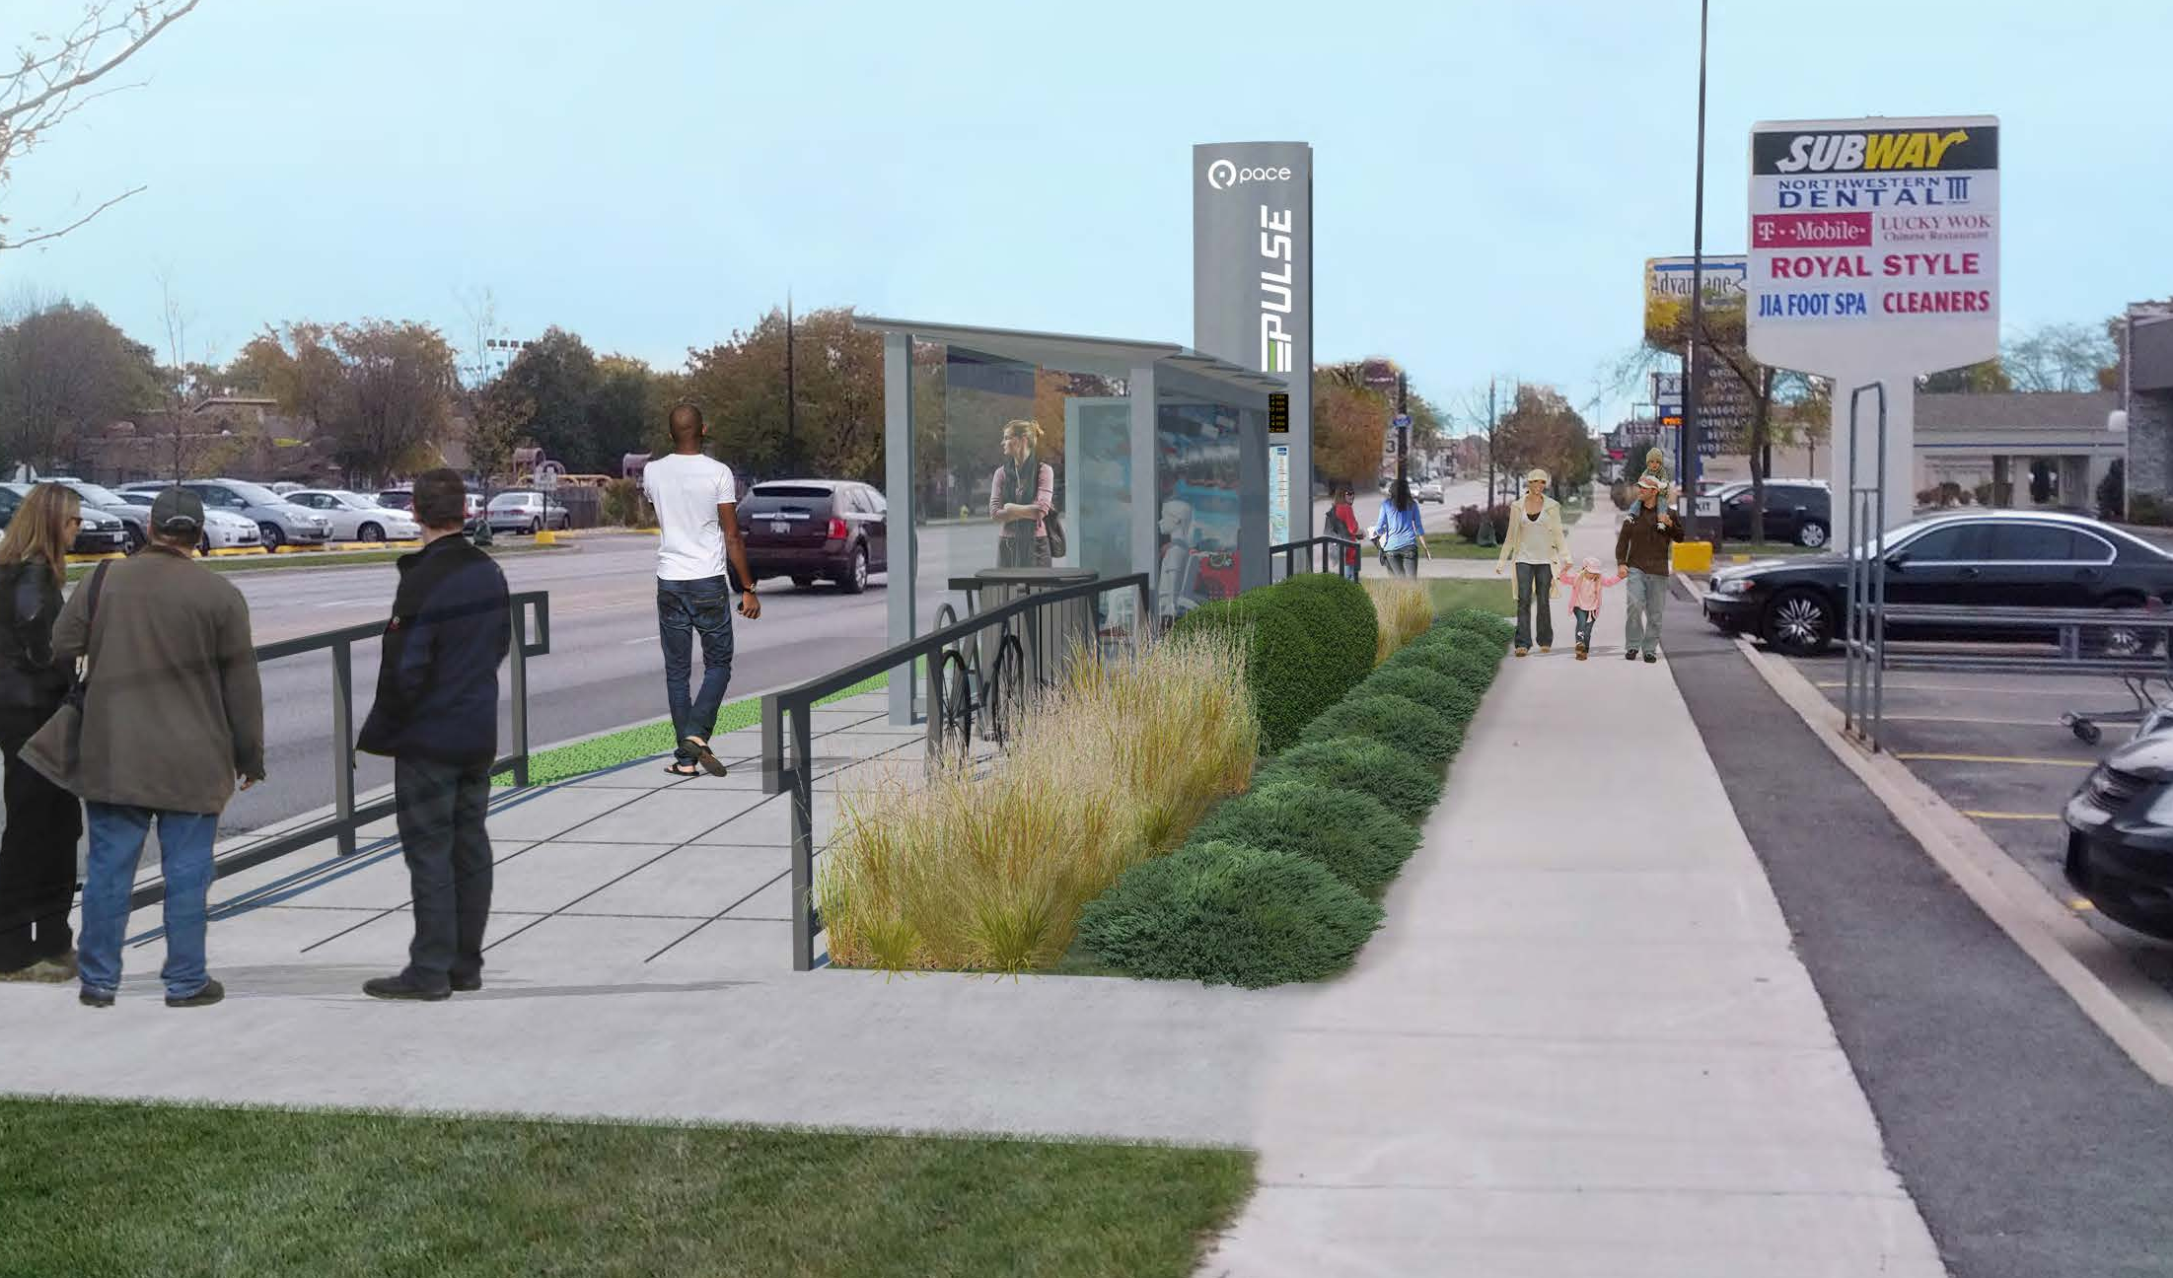
Station Examples
Notes:
Oakton SB

Slide 26
Future Work
Additional Pulse corridors
  Lane use / corridor studies and improvements
  Enhancing agency capacity
  Ramping up demand
Upgrading BRT Features
  Bus-only lanes
  Pre-paid fare collection
Notes:
Looking beyond the near-term corridors, Pace will continue conducting community planning work to “prime” future Pulse corridors for successful implementation. (North Avenue, Harlem Avenue). We are also using lessons learned from Milwaukee to more efficiently and effectively tackle future projects and in so doing develop our staffing, departmental and agency-wide capacities. The hope is that Pulse will be an attractive service option and entice demand for more routes – the more community support, the easier it will be to implement. Lastly, Pulse will be an evolving service – station, vehicle, infrastructure and technology upgrades are expected to help continually improve travel times and enhance passenger experience.

Slide 27
The Technology “Bridge”
ITS will allow…
  Schedule adherence
  Travel time savings
  Predictability
  Reliability
  Enhanced user experience
Notes:
However, while bus-only lanes and other features of “true BRT” will require more time, effort and coordination to achieve, Pace has had great success with planning and implementing the other major technology-based “smart system” component that will support improving speed for Pulse services – that being the ITS improvements and coordination work that Taqhi summarized. Bringing us back to where we started this discussion, Pulse is just one example of where ITS and other technology features will benefit both the agency and our passengers.

Slide 28
Questions
Contact Info: Taqhi.Mohammed@pacebus.com
Ryan.Ruehle@Pacebus.com
Phone No: (847) 228 4287

